Slide 1

Recommendations on Arrondissement / Neighbourhoods to open a new restaurant in Paris
A Capstone project

Slide 2
Business Problem
A contractor is looking towards opening a restaurant in the city of Paris.
The contractor has not yet decided on the neighbourhood where he is going to open the restaurant. He is looking for recommendations on the neighbourhoods to open a restaurant in Paris.
The contractor is also interested in knowing the cuisine that would attract the most customers in that area.

Slide 3
Data Acquisition
A public dataset from Kaggle containing food preferences information was one of the datasets used in this project.
The information regarding the population densities among the various neighbourhood in Paris have been taken from wikipedia.
The FourSquare API would be used to fetch the venue and restaurant details for the neighbourhoods / arrondissements.

Slide 4
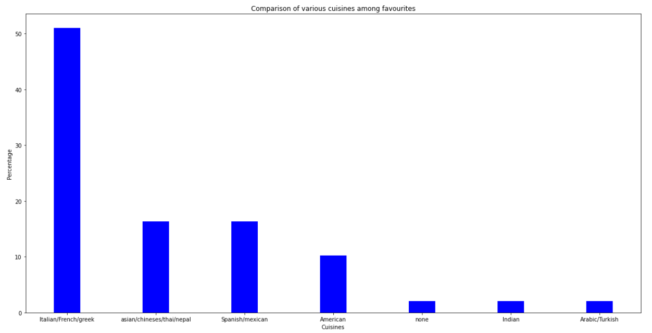
Cuisine preference of people who frequent eat at restaurants
Insight :
The section of people who frequently visit restaurants favour Italian / French/ Greek cuisines the most

Slide 5
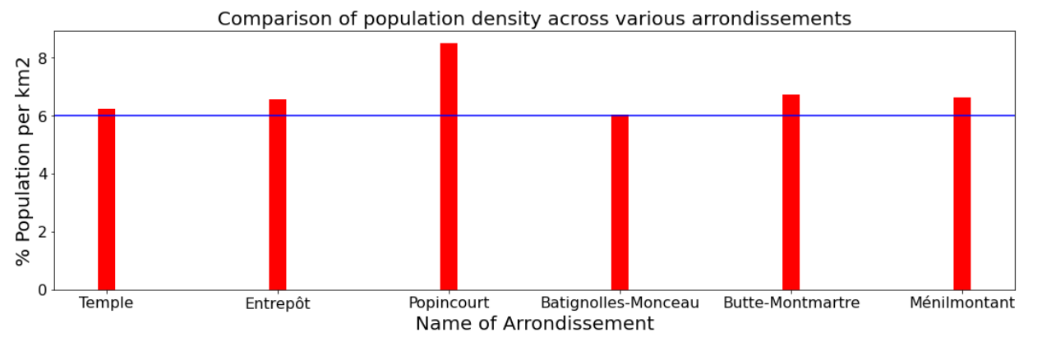
Most densely populated neighbourhoods of Paris:
Insight :
The following are the most densely populated neighbourhoods / arrondissements of Paris :
• Batignolles-Monceau
• Butte-Montmartre
• Entrepôt
• Ménilmontant
• Popincourt
• Temple
Please note : In this diagram, only the neighbourhoods that had population of over 6% of the total population density of Paris are shown.

Slide 6
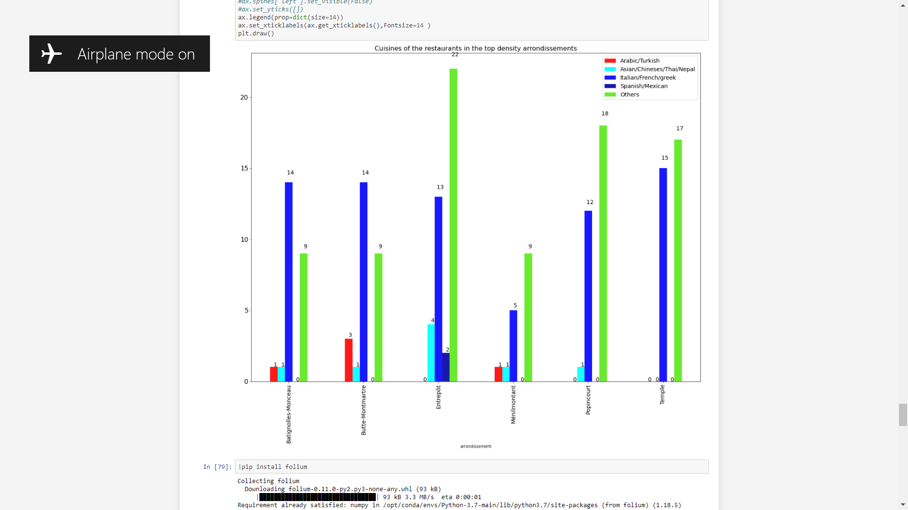
Hotels’ Distribution in most populated neighbourhoods in Paris
Insight :
It can be seen that the
Ménilmontant has less number of restaurants with Italian , Greek or French cuisines.
This neighbourhood has high population density and less number of Italian/Greek/French cuisines.

Slide 7
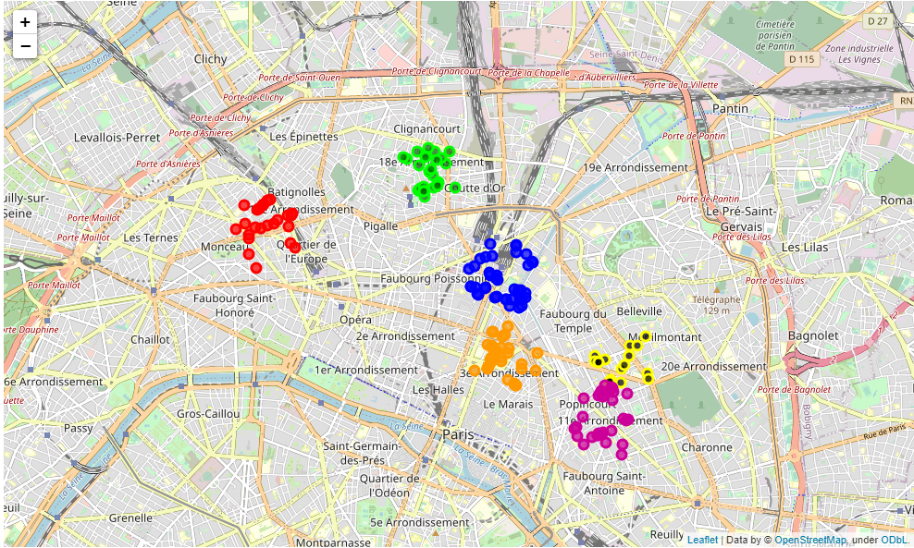
Hotels’ Distribution in most populated neighbourhoods in Paris
Insight :
The restaurants in our target neighbourhood Ménilmontant are highlighted as a black dot with a yellow outline.

Slide 8
Inference:
Based on the plots discussed, the following observations were made:
It can be clearly seen that the Italian/Greek/French cuisine is the cuisine that this section of people who dine out frequently prefer.
2) It can be understood that most densely populated neighbourhoods:
• Batignolles-Monceau
• Butte-Montmartre
• Entrepôt
• Ménilmontant
• Popincourt
• Temple
3) This shows that Ménilmontant has the least amount of Italian/Greek/French cuisine restaurant. Hence it is most probable that the people might need a new Italian/French/Greek cuisine restaurant in this area

Slide 9
Conclusion:
The frequent restaurant goers preferences were analysed and their food preferences were analysed.
It could be seen that regular customers favour Italian, Greek and French cuisines.
The population distribution across the various neighbourhoods across Paris was analysed.
Ménilmontant is one among the top densely populated neighbourhoods of Paris.
Based on those analysis, it is recommended to open a restaurant that specializes on Italian/Greek/French cuisines in the Ménilmontant neighbourhood / arrondissement.

